Slide 1
C♯ Dependency Injection Unit Testing EF
Rasmus Lystrøm
External Associate Professor
ITU

Slide 2
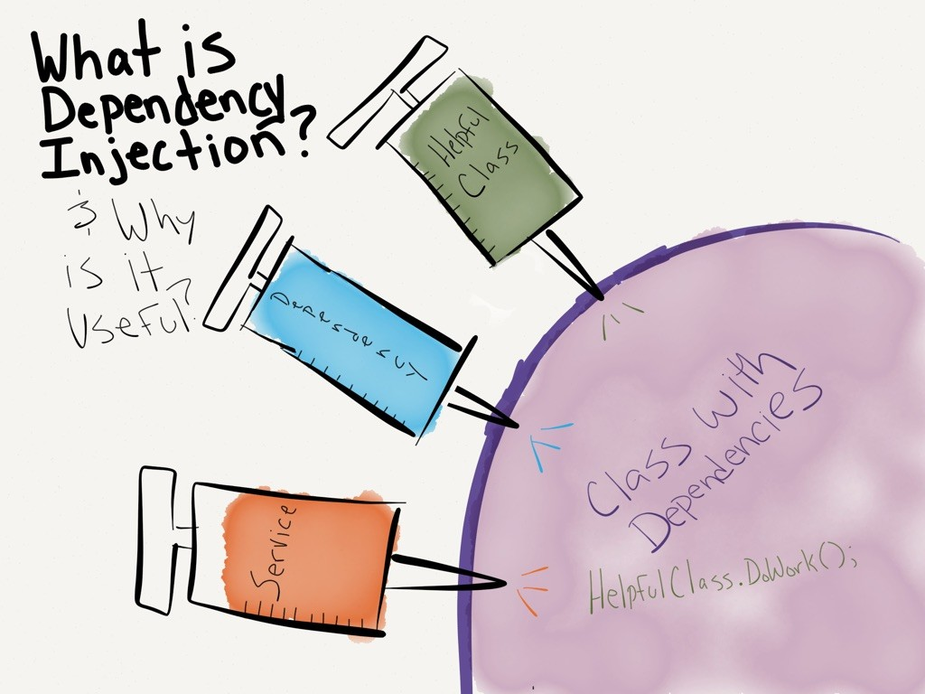
http://dwiardiirawan.com/index.php/2016/05/18/what-is-dependency-injection-and-what-are-the-advantage/

Slide 3
Dependency Injection (DI)
Software design pattern which implements Inversion of Control (IoC)
Constructor Injection
Property (setter) Injection
Interface Injection

Slide 4
Structered readable code Testable code Dependency Inversion Principle Separation of Concerns Rock SOLID!!! AWESOME!!
Pun intended

Slide 5
Programming to interface, not implementation…
public interface IFooService : IDisposable
{
bool Update(Foo foo);
}

Slide 6
Constructor Injection
public class Worker : IDisposable
{
private readonly IFooService _service;
public Worker(IFooService service)
{
_service = service;
}
public bool DoWork(FooDto fooDto)
{
// Implementation
}
public void Dispose()
{
_service.Dispose();
}
}
Private readonly field
Initialize from constructor
Remember to call Dispose…

Slide 7
Property Injection
Public setter
public class Worker : IDisposable
{
public IFooService Service { private get; set; }
public void DoWork(FooDto foo)
{
// Implementation
}
public void Dispose()
{
Service?.Dispose();
}
}
Dispose with the King…

Slide 8
Interface Injection
public interface IServiceSetter<T>
{
void SetService(T service);
}

Slide 9
Interface Injection II
Interface
public class Worker : IServiceSetter<IFooService>, IDisposable
{
private IFooService _service;
public void SetService(IFooService service)
{
_service = service;
}
public void DoWork(FooDto fooDto)
{
// Implementation
}
public void Dispose()
{
_service?.Dispose();
}
}
Implement interface

Slide 10
Interface Injection III
public interface IServiceSetter<T>
{
T Service { set; }
}

Slide 11
Interface Injection IV
Interface
public class Worker : IServiceSetter<IFooService>, IDisposable
{
public IFooService Service { private get; set; }
public bool DoWork(FooDto fooDto)
{
// Implementation
}
public void Dispose()
{
Service?.Dispose();
}
}
Implement interface

Slide 12
Best practices
Use constructor injection
Use Adapter to enable interface if needed
Implement IDisposable
Use an IoC container

Slide 13
When interface not possible directly, use Adapter pattern
Pun intended
public sealed class FoolishService
{
public bool Update(Foo foo)
{
// Implementation
}
}

Slide 14
When interface not possible directly, use Adapter pattern II
public class FoolishServiceAdapter : IFooService
{
private readonly FoolishService _service = new FoolishService();
public bool Update(Foo foo)
{
return _service.Update(foo);
}
public void Dispose()
{
}
}

Slide 15
Unit Testing

Slide 16
Best Practices
Single Responsibility Principle
Never test against a live database, file, or web service
Use either mocks or stubs
Only test the ”System Under Test”

Slide 17
Stub testing
Test stub
public class FooServiceFalseStub : IFooService
{
public bool Update(Foo foo)
{
return false;
}
public void Dispose()
{
}
}

Slide 18
Stub testing II
public class WorkerTests
{
[Fact]
public void DoWork_when_IFooService_Update_false_returns_false()
{
IFooService service = new FooServiceFalseStub();
using (var worker = new Worker(service))
{
var result = worker.DoWork(new FooDto());
Assert.False(result);
}
}
}

Slide 19
Mock testing
Mock using Moq
public class WorkerTests
{
[Fact]
public void DoWork_when_IFooService_Update_false_returns_false()
{
var mock = new Mock<IFooService>();
IFooService service = mock.Object;
using (var worker = new Worker(service))
{
var result = worker.DoWork(new FooDto());
Assert.False(result);
}
}
}

Slide 20
Mock testing II
Configure the mock
public class WorkerTests
{
[Fact]
public void DoWork_when_IFooService_Update_true_returns_true()
{
var mock = new Mock<IFooService>();
mock.Setup(m => m.Update(It.IsAny<Foo>())).Returns(true);
using (var worker = new Worker(mock.Object))
{
var result = worker.DoWork(new FooDto());
Assert.True(result);
}
}
}

Slide 21
Demo

Slide 22
Testing Entity Framework

Slide 23
Best practices
Implement IDisposable
Wrap in logical units/service classes/repositories
Don’t test built in code…
Program to interface

Slide 24
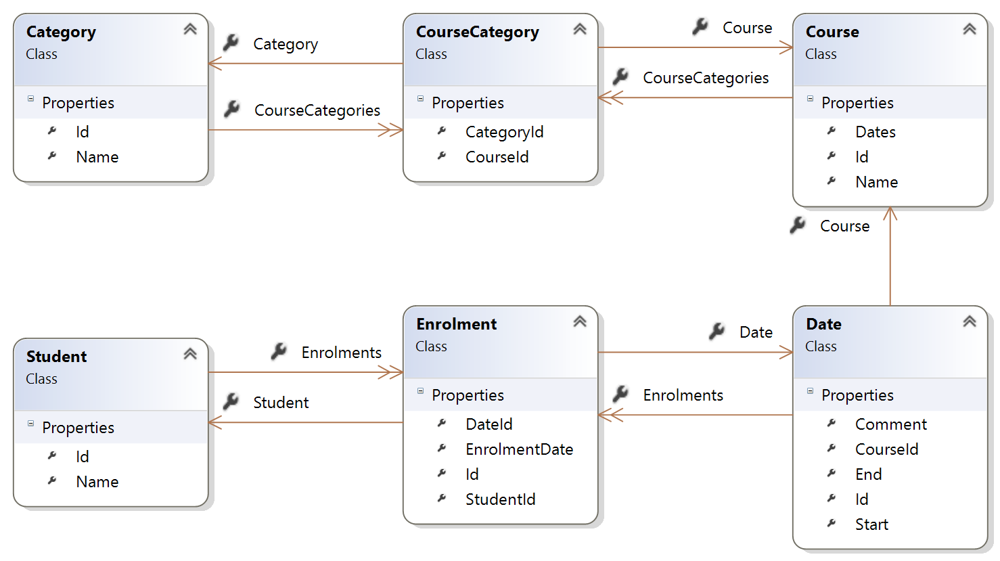
Entity Model

Slide 25
IStudentRepository
Interface to enable Dependency Injection at the next layer
public interface IStudentRepository : IDisposable
{
IEnumerable<StudentListDto> Read();
IEnumerable<StudentListDto> Read(Status status);
bool Enrol(int studentId, int dateId);
int Create(StudentCrudDto student);
bool Update(StudentCrudDto student);
bool Delete(int studentId);
}

Slide 26
Enable InMemoryDatabase for DbContext class
public MyContext()
{
}
public MyContext(DbContextOptions<CourseBaseContext> options)
: base(options)
{
}
"dependencies": {
""Microsoft.EntityFrameworkCore.InMemory": "1.0.1
},
In test library
https://docs.efproject.net/en/latest/miscellaneous/testing.html

Slide 27
Demo

